Slide 1

Exploring decoding of reality from multivariate analysis perspective
Version : Pilot 1
Saurabh Ranjan

Slide 2
Reality Monitoring
Reality monitoring is our ability to determine whether the experience is internal (e.g. imagination) or external (e.g. visual perception).
Understanding reality monitoring is essential in cases like obsessive-compulsive disorders and psychosis as it is compromised.
We need to understand the temporal characteristics of neural activity that help us segregate internal and external experiences.
Perceptual Reality Monitoring Theory postulates a “discriminator” that can segregate imagined and perceived experiences, but its neurodynamic is unknown.
We use the temporal generalization method to understand how underlying neurodynamics can separate perceived experiences from imagined experiences.

Slide 3
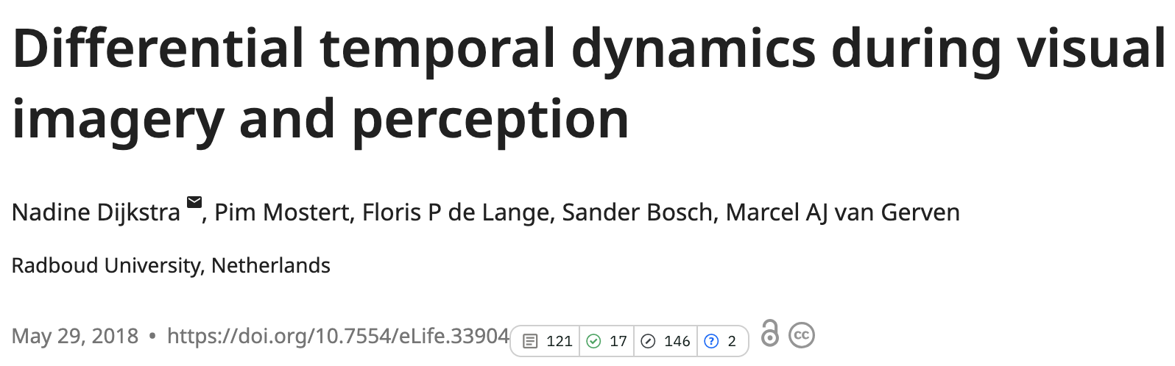
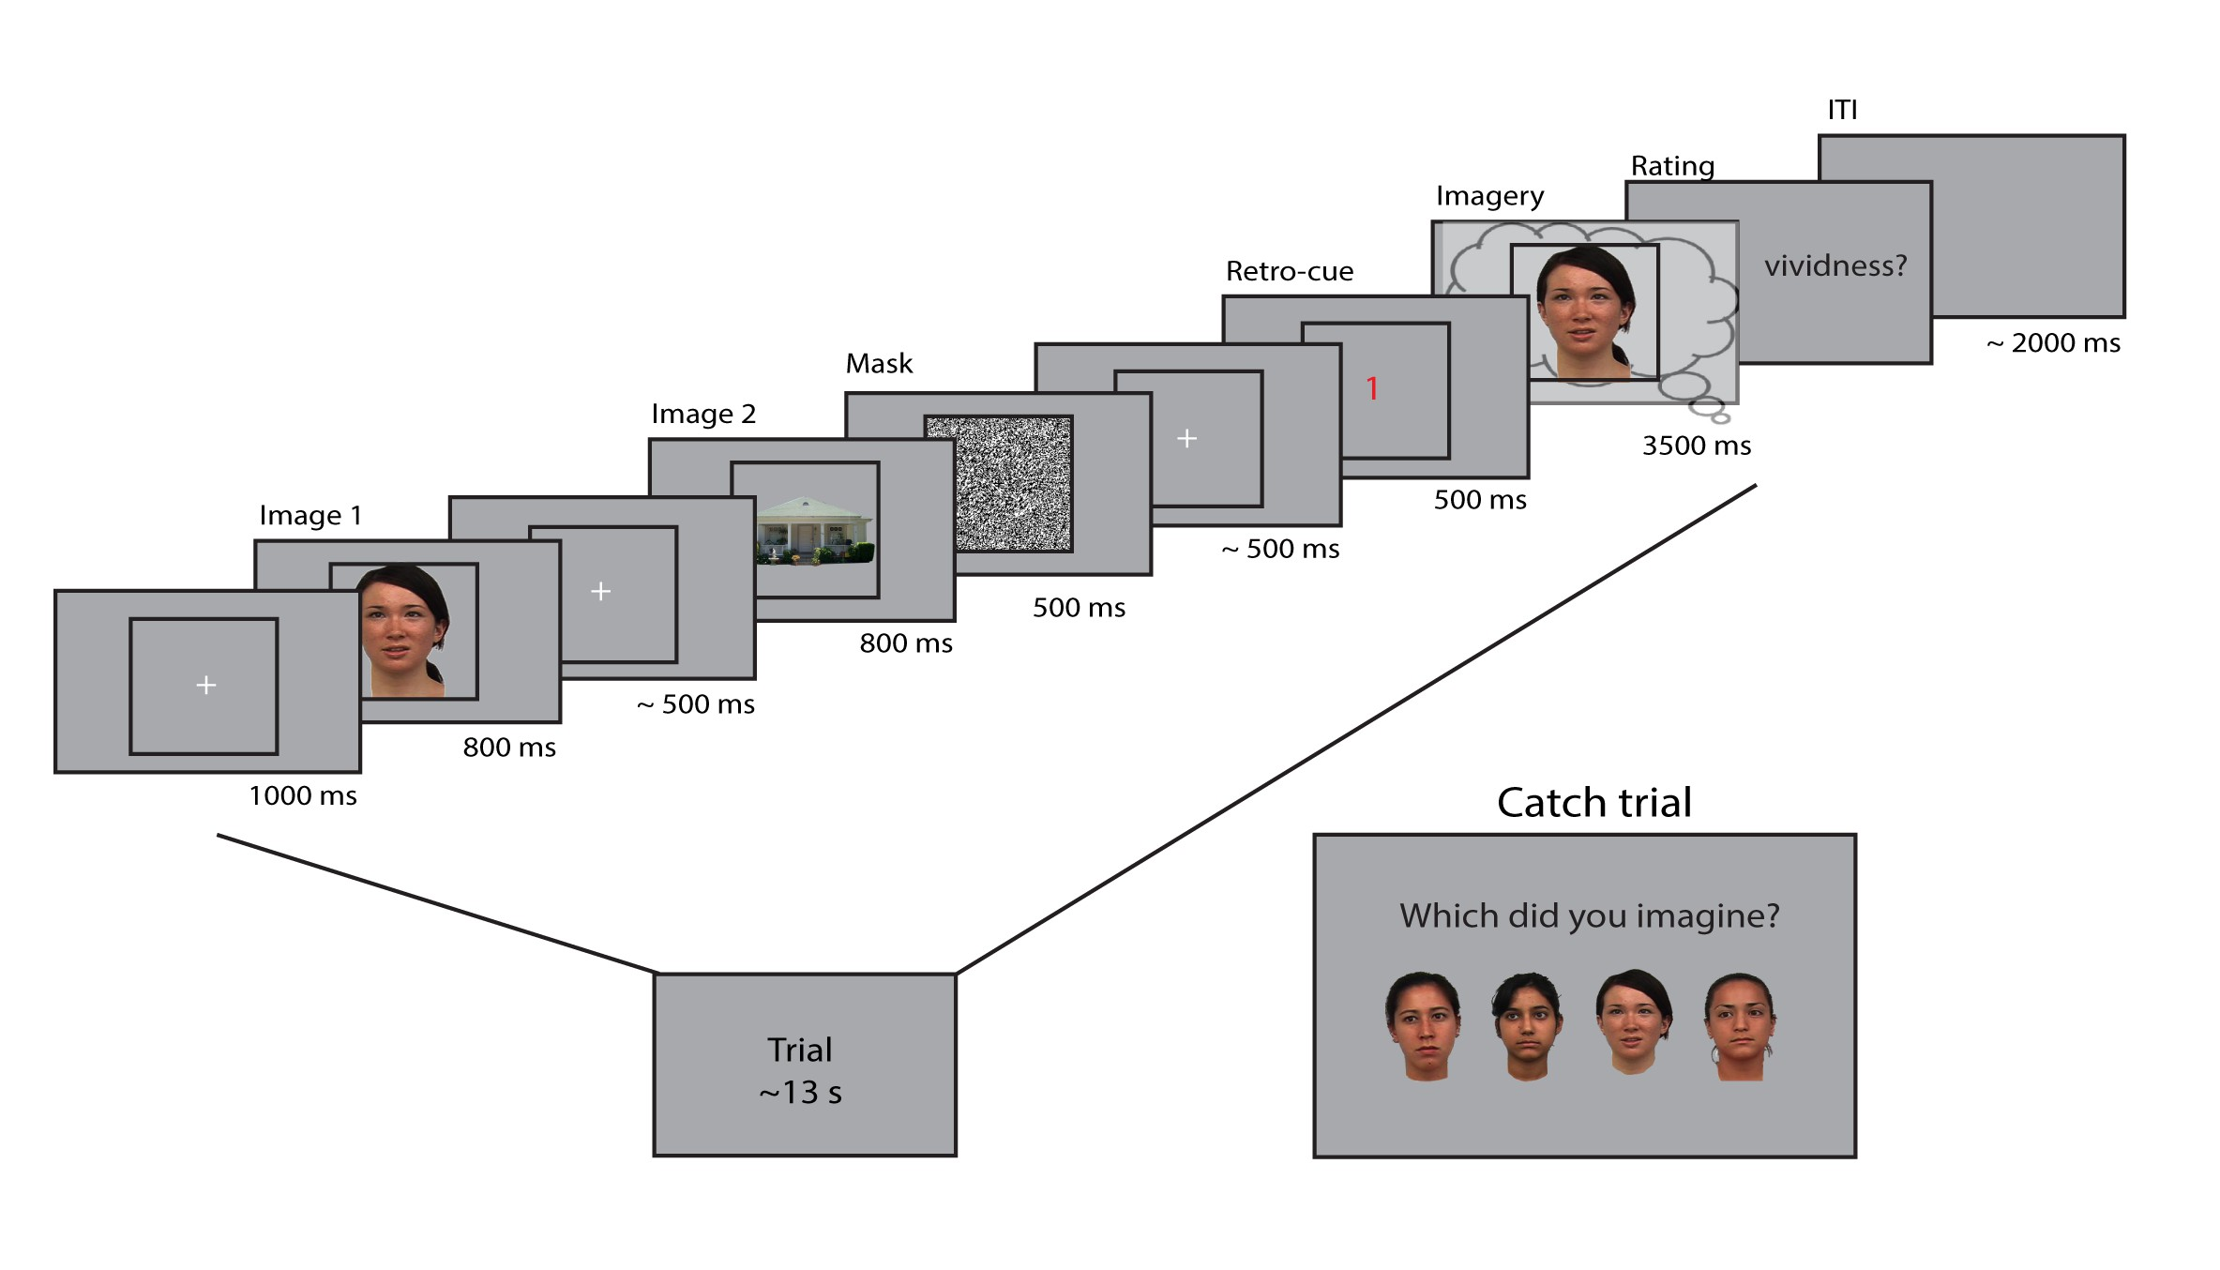
Behavioral Experiment and Dataset
Participants imagined Image 1 or Image 2 based on the retro-cue.
# participants (N) = 24
RESEACH QUESTION:
What is the type of neural generator activity that can
distinguish between perception and imagination? OR
What is temporal generalization across perceived and imagined experiences?

Slide 4
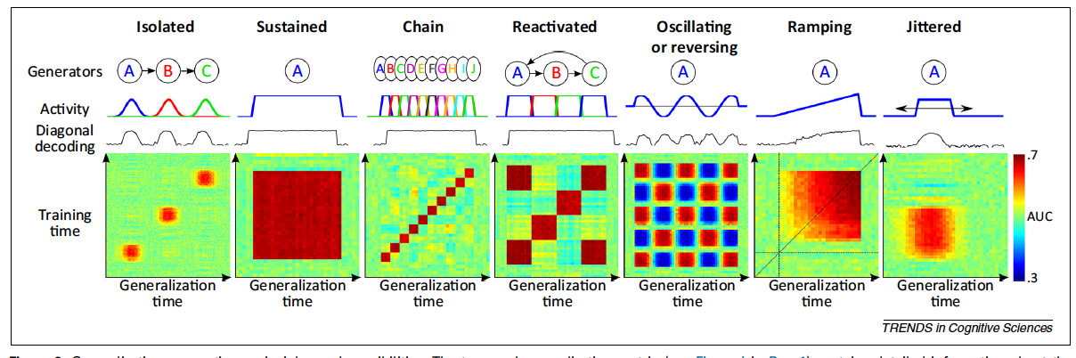
Temporal generalization/neural generators

Slide 5
Current Study
Experiment 1:
Whole Brain Level
Regional Level
Classifier Used: LDA; Target: Perceived/Imagined condition.
Epoch Time Used:
Perception: 200ms prior to onset of 1st image to 1000ms after the onset of 1st image.
Imagination: 200ms prior to onset of imagery window to 1000ms after the onset of imagery window
Experiment 2
Whole Brain Level
Regional Level
Classifier Used: LDA; Target: Perceived/Imagined condition.
Epoch Time Used:
Perception: 200ms prior to onset of 1st image to 800ms after the onset of 1st image.
Imagination: 200ms prior to pre-cue to 800ms after the onset of pre-cue.

Slide 6
Methods:
We extracted relevant time samples from each subject for imagined and perceived parts in a trial.
For each subject, we did Group-based Kfold with K = 2; the classifier was trained on ‘House’ stimuli to classify Perceived, imagined, and tested on ‘Face’ stimuli. The mean performance on the two test sets was taken as the classifier's performance on that subject.
Classifier was trained and tested at each time point and generate temporal generalization matrix.
We preprocessed data by normalizing (standard scalar) and then performing PCA. We used 15 components after the PCA of sensor values at each time point.
Performance was measured using the AUC score.

Slide 7
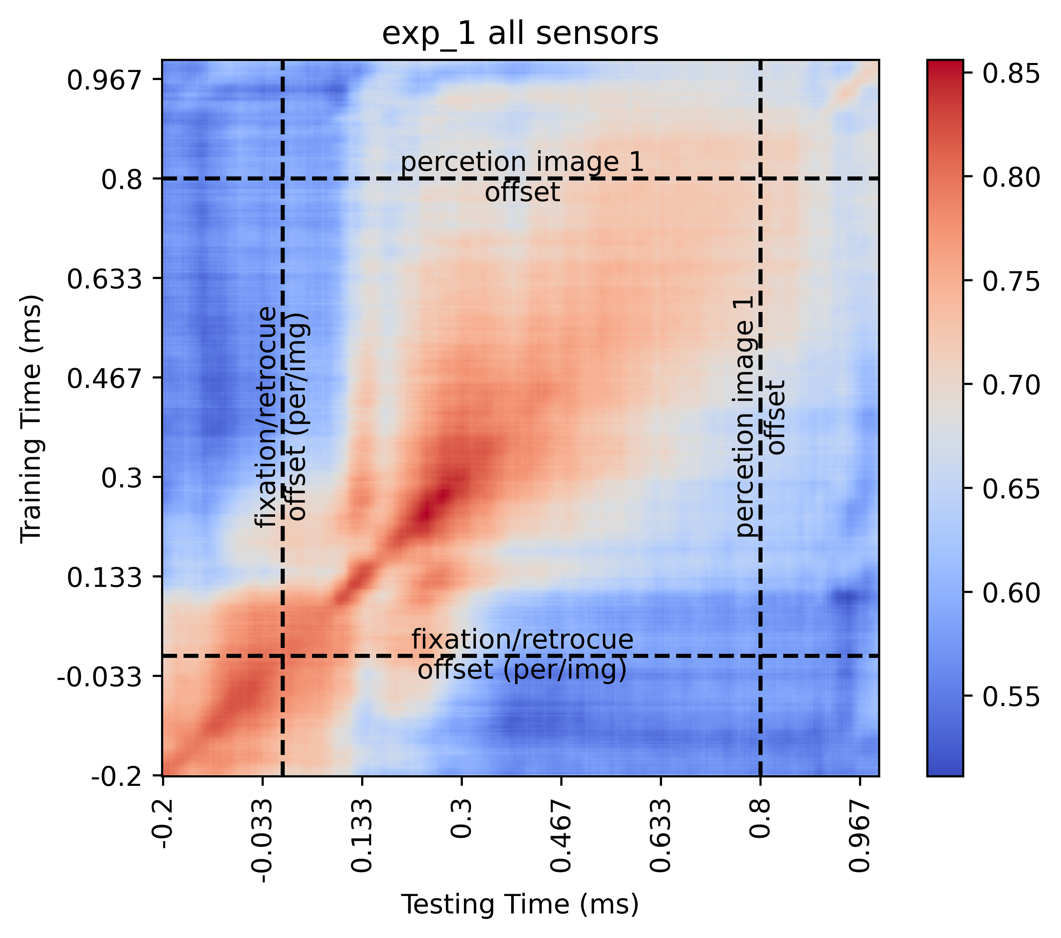
EXPERIMENT 1.A (WHOLE BRAIN LEVEL)
Classifier Used: LDA; Target: Perceived/Imagined condition.
Epoch Time Used:
Perception: 200ms prior to onset of 1st image to 1000ms after the onset of 1st image.
Imagination: 200ms prior to onset of imagery window to 1000ms after the onset of imagery window

Slide 8
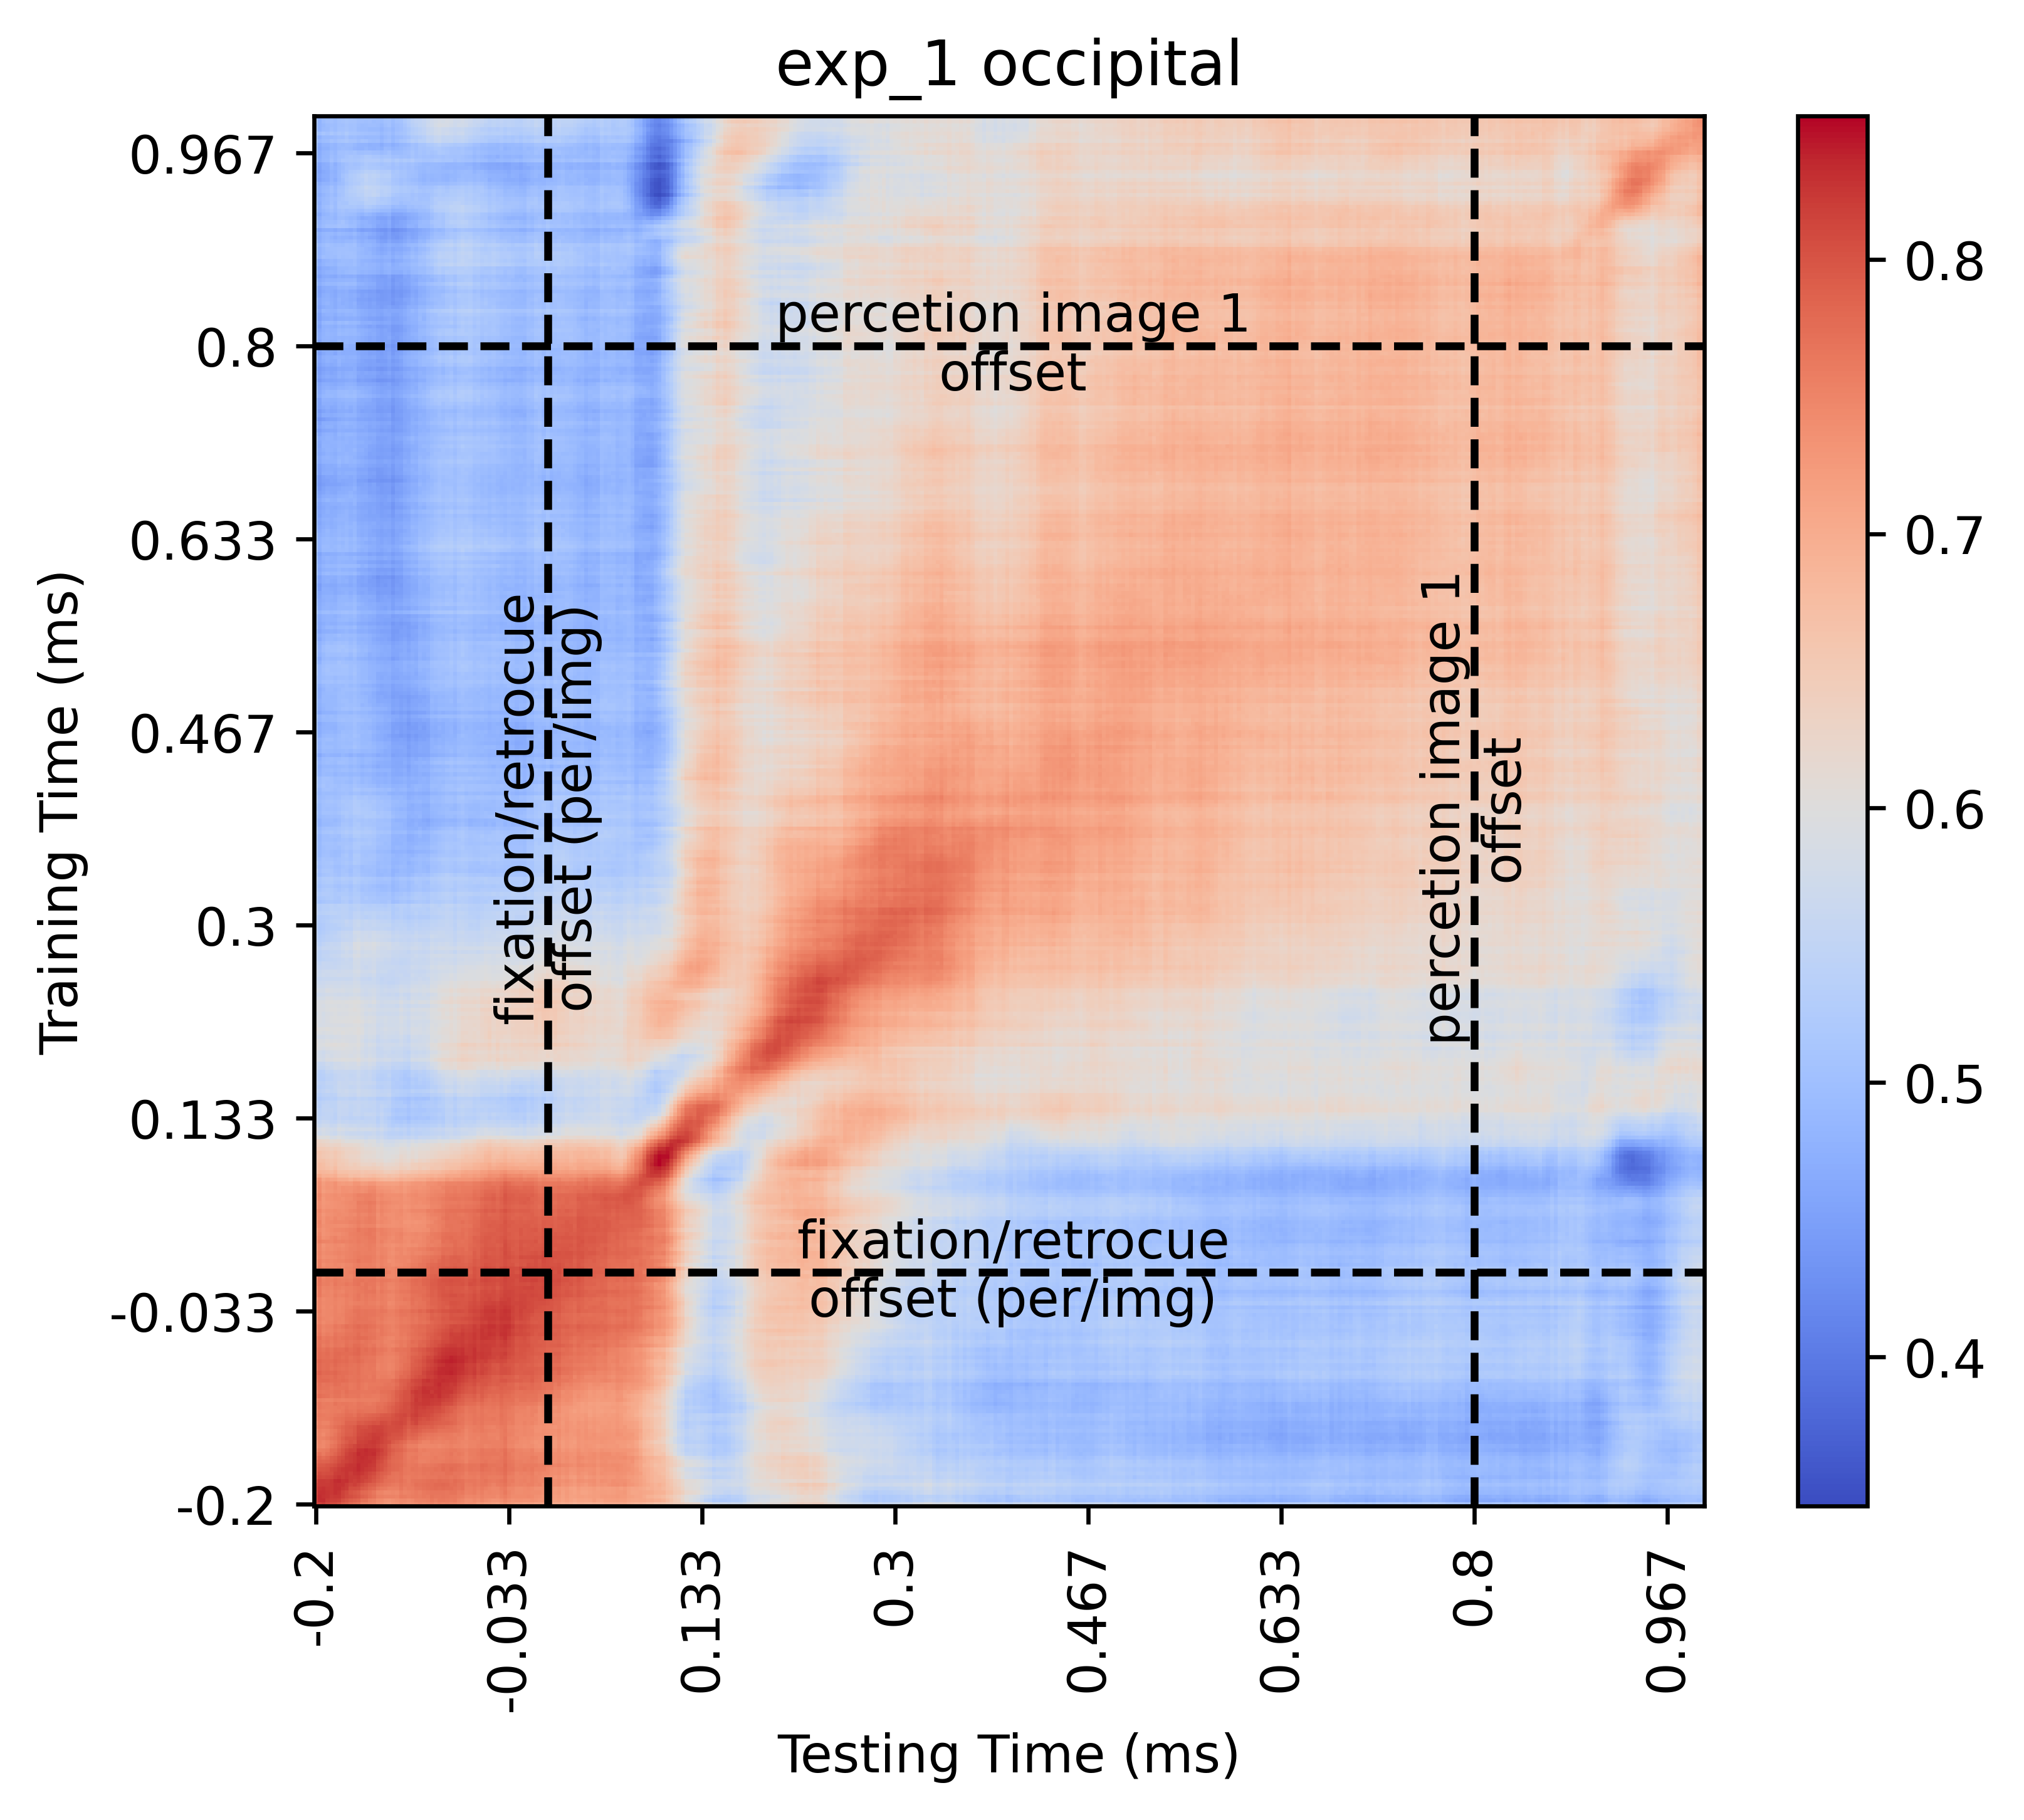
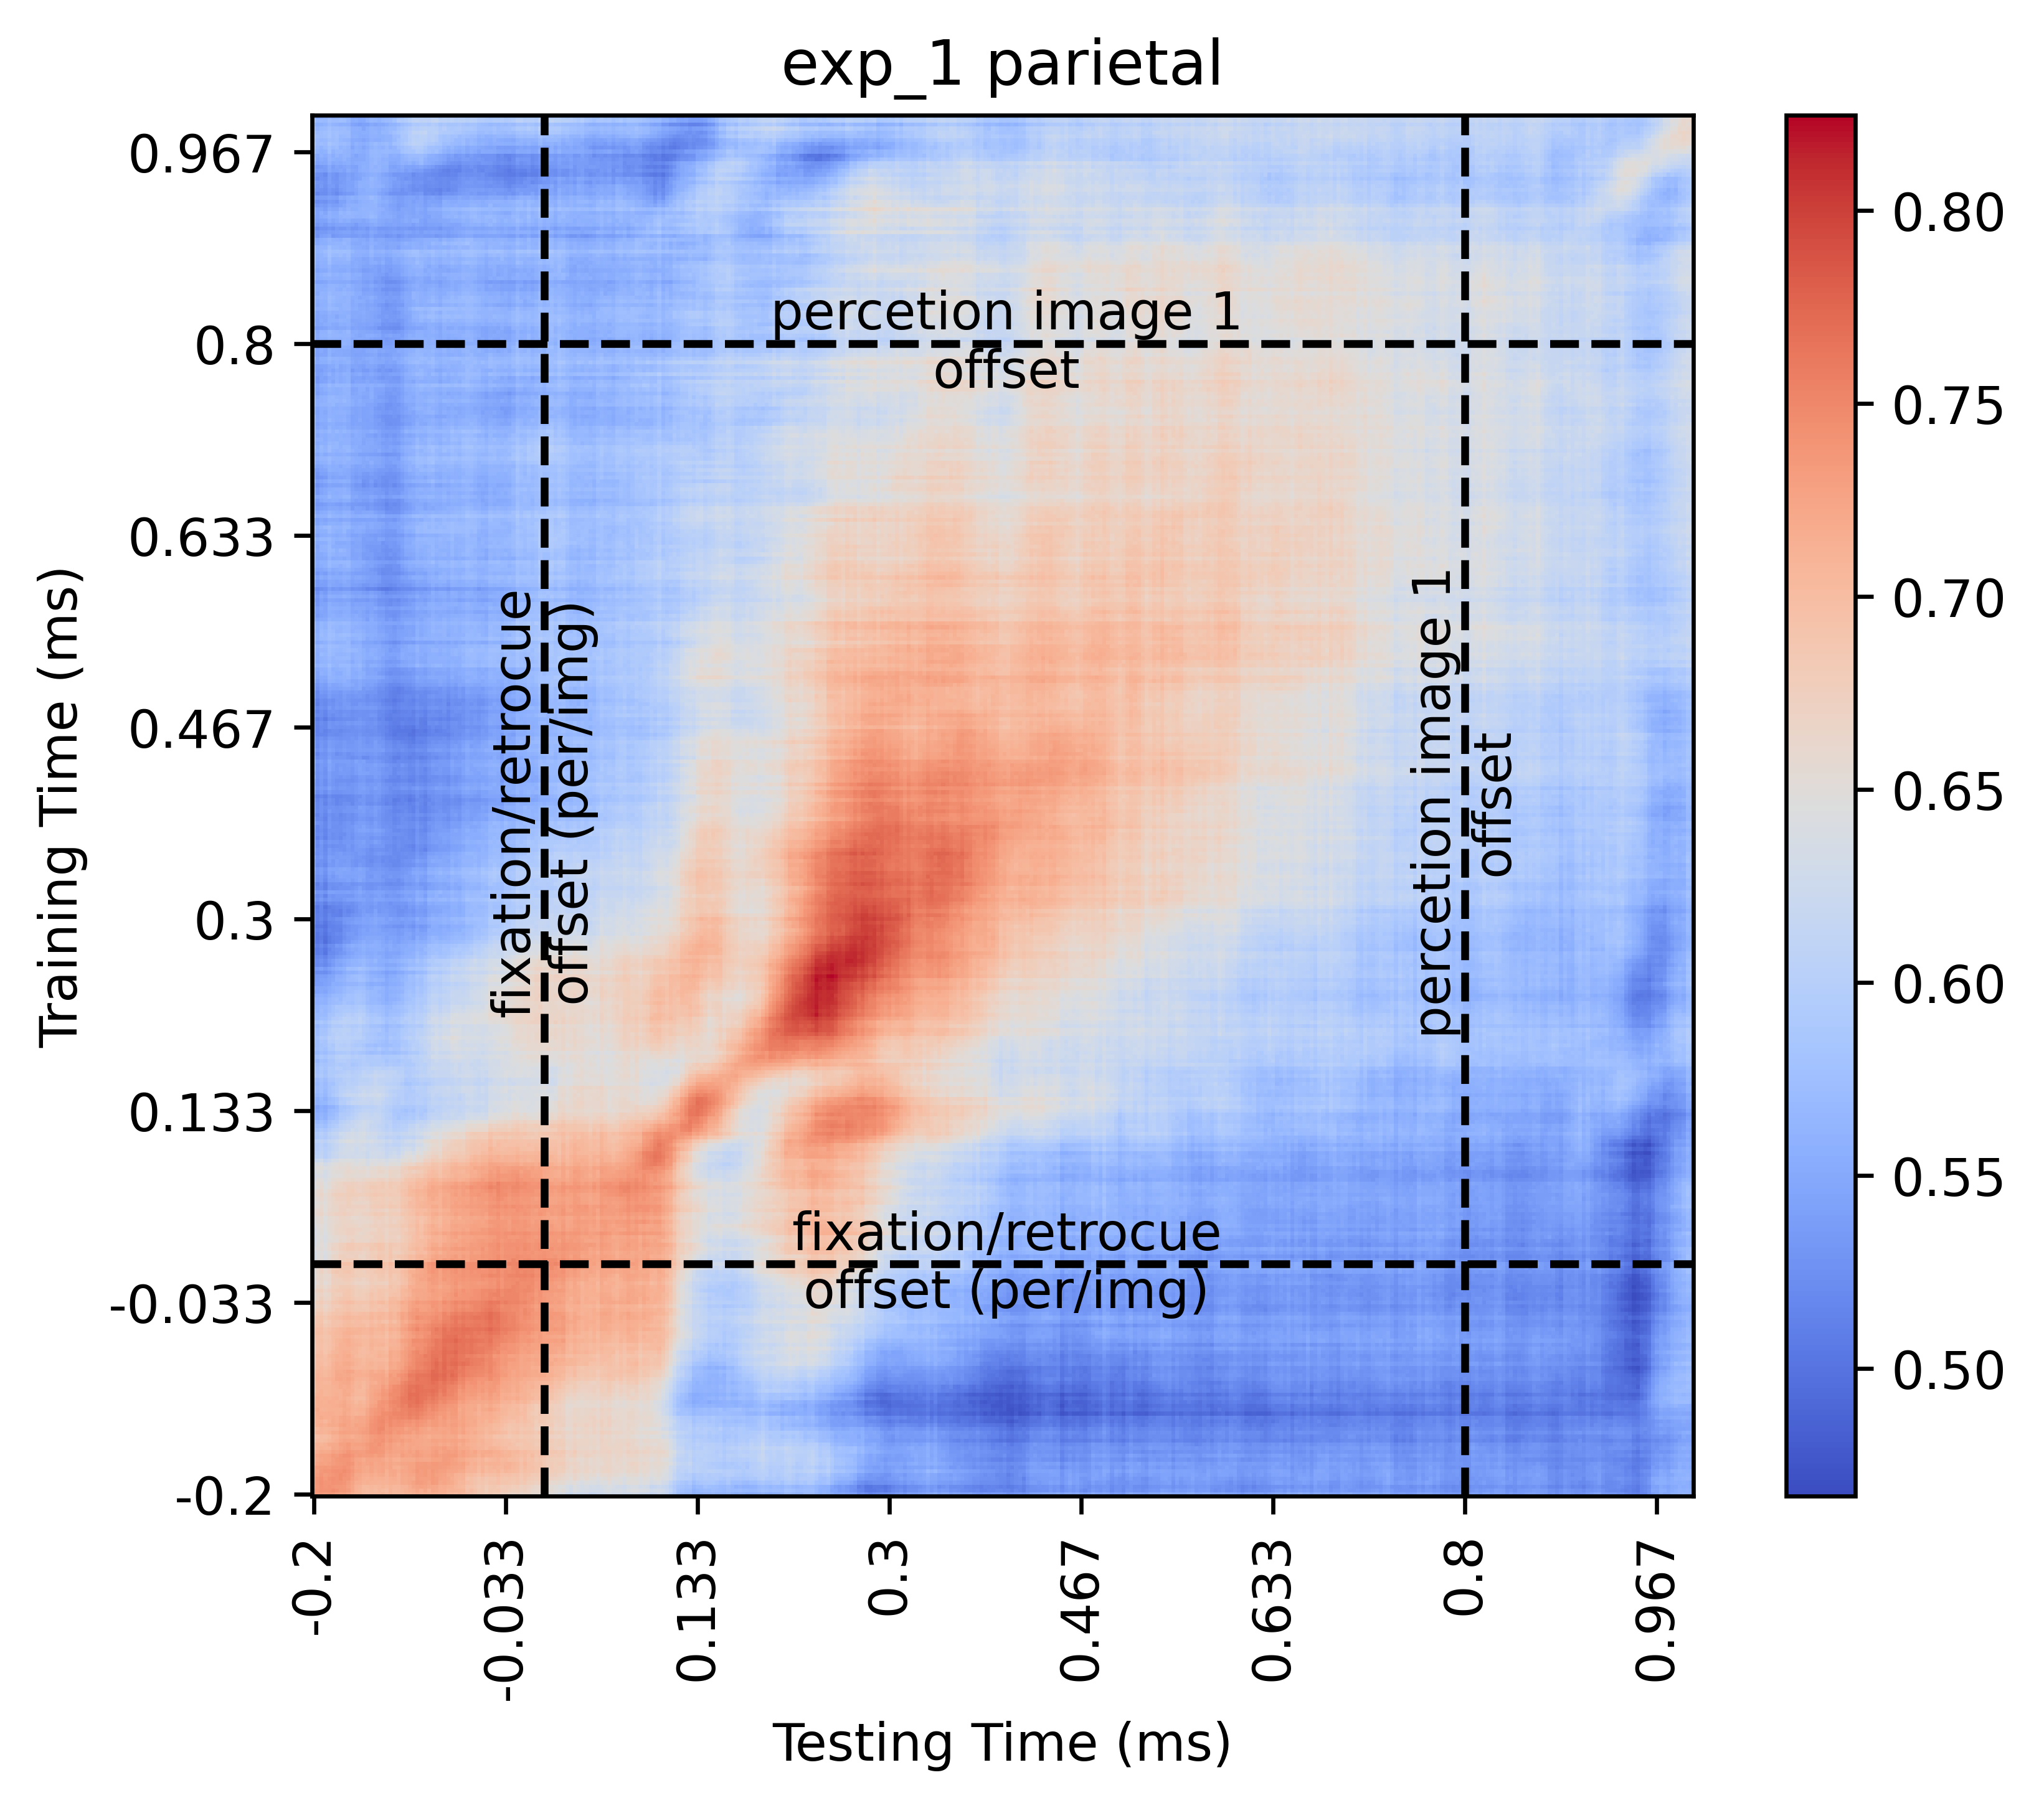
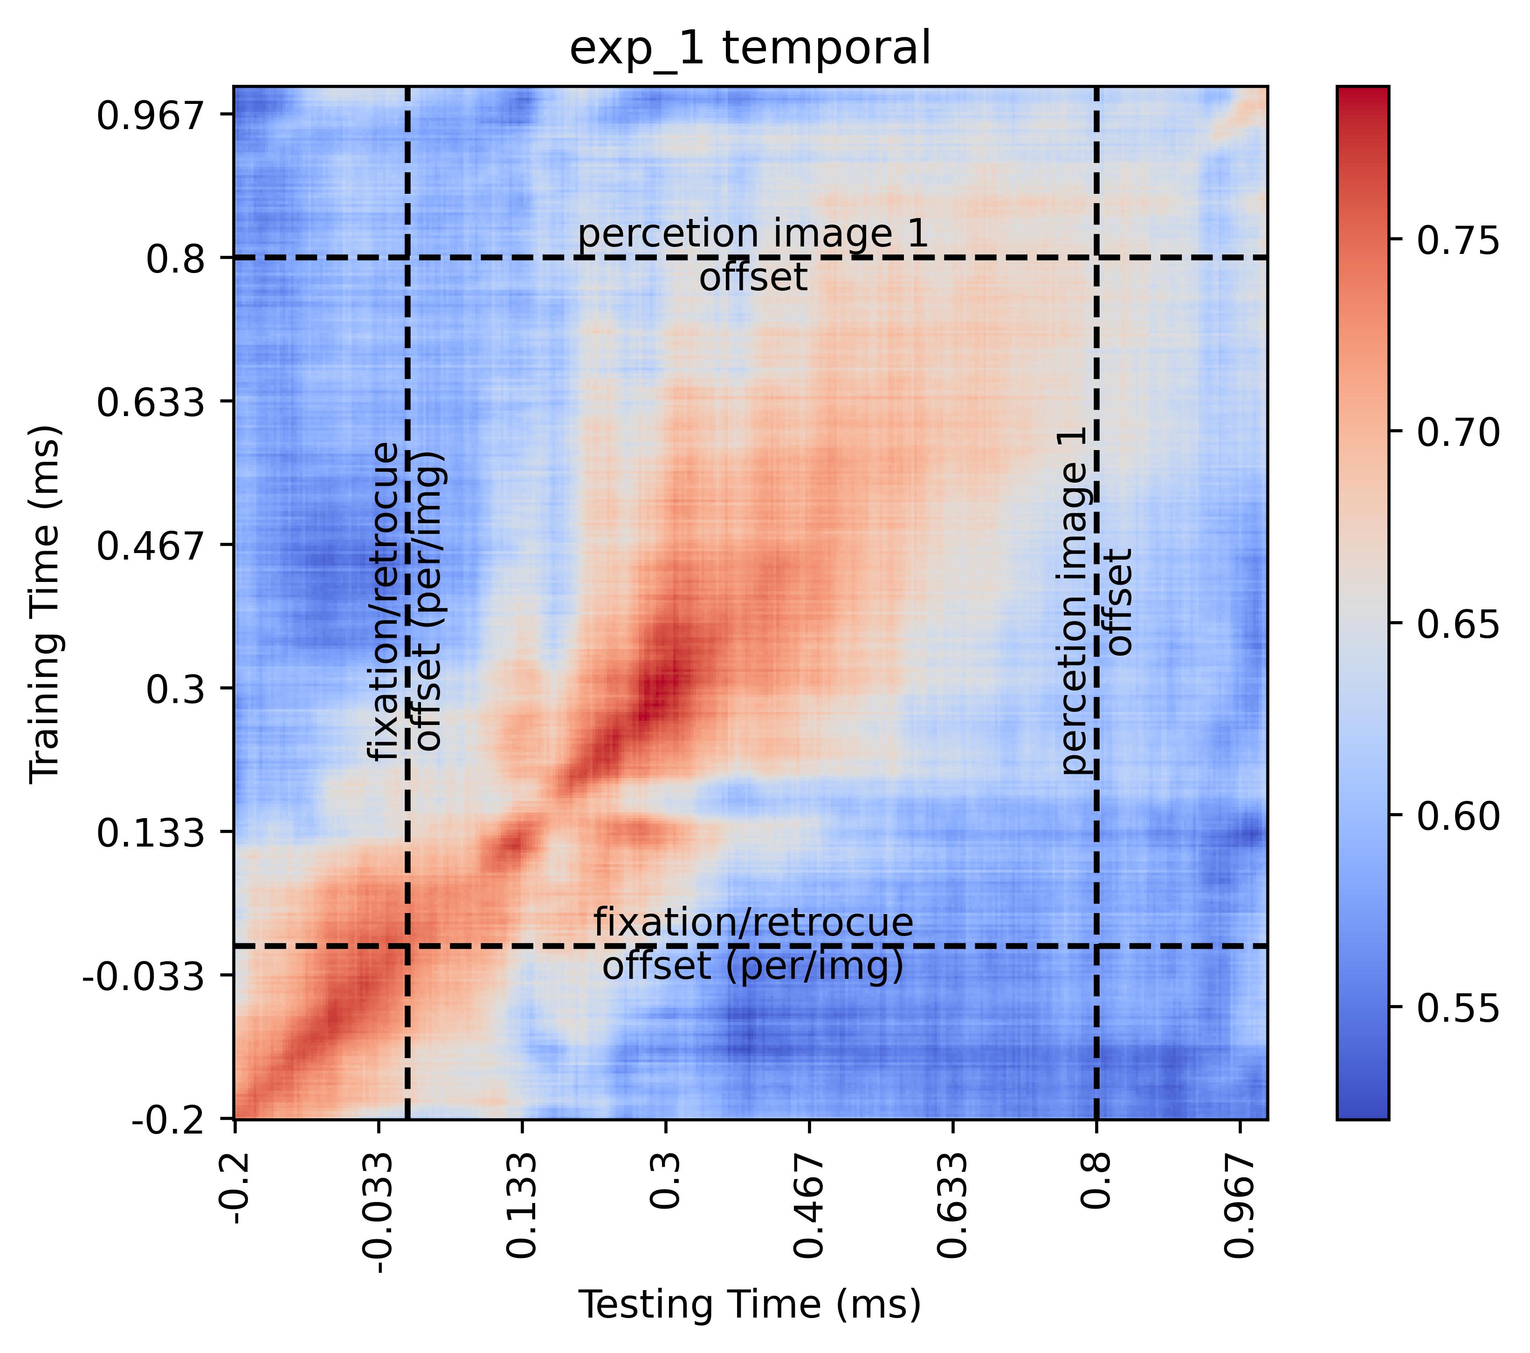
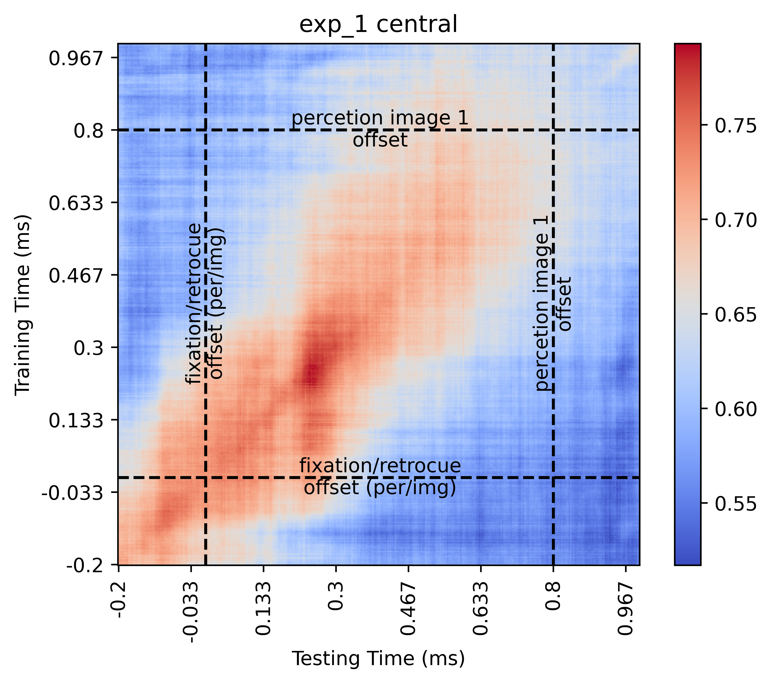
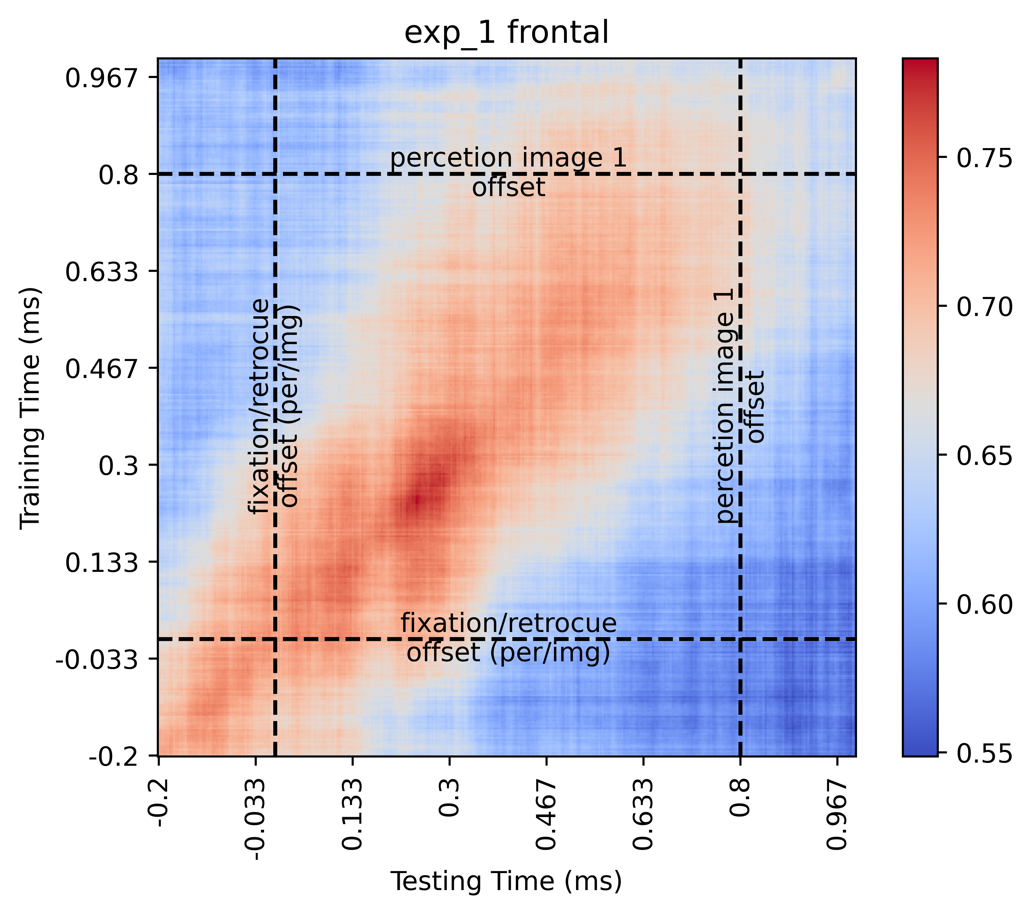
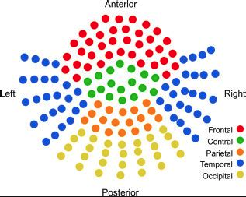
EXPERIMENT 1.B (REGIONAL LEVEL)

Slide 9
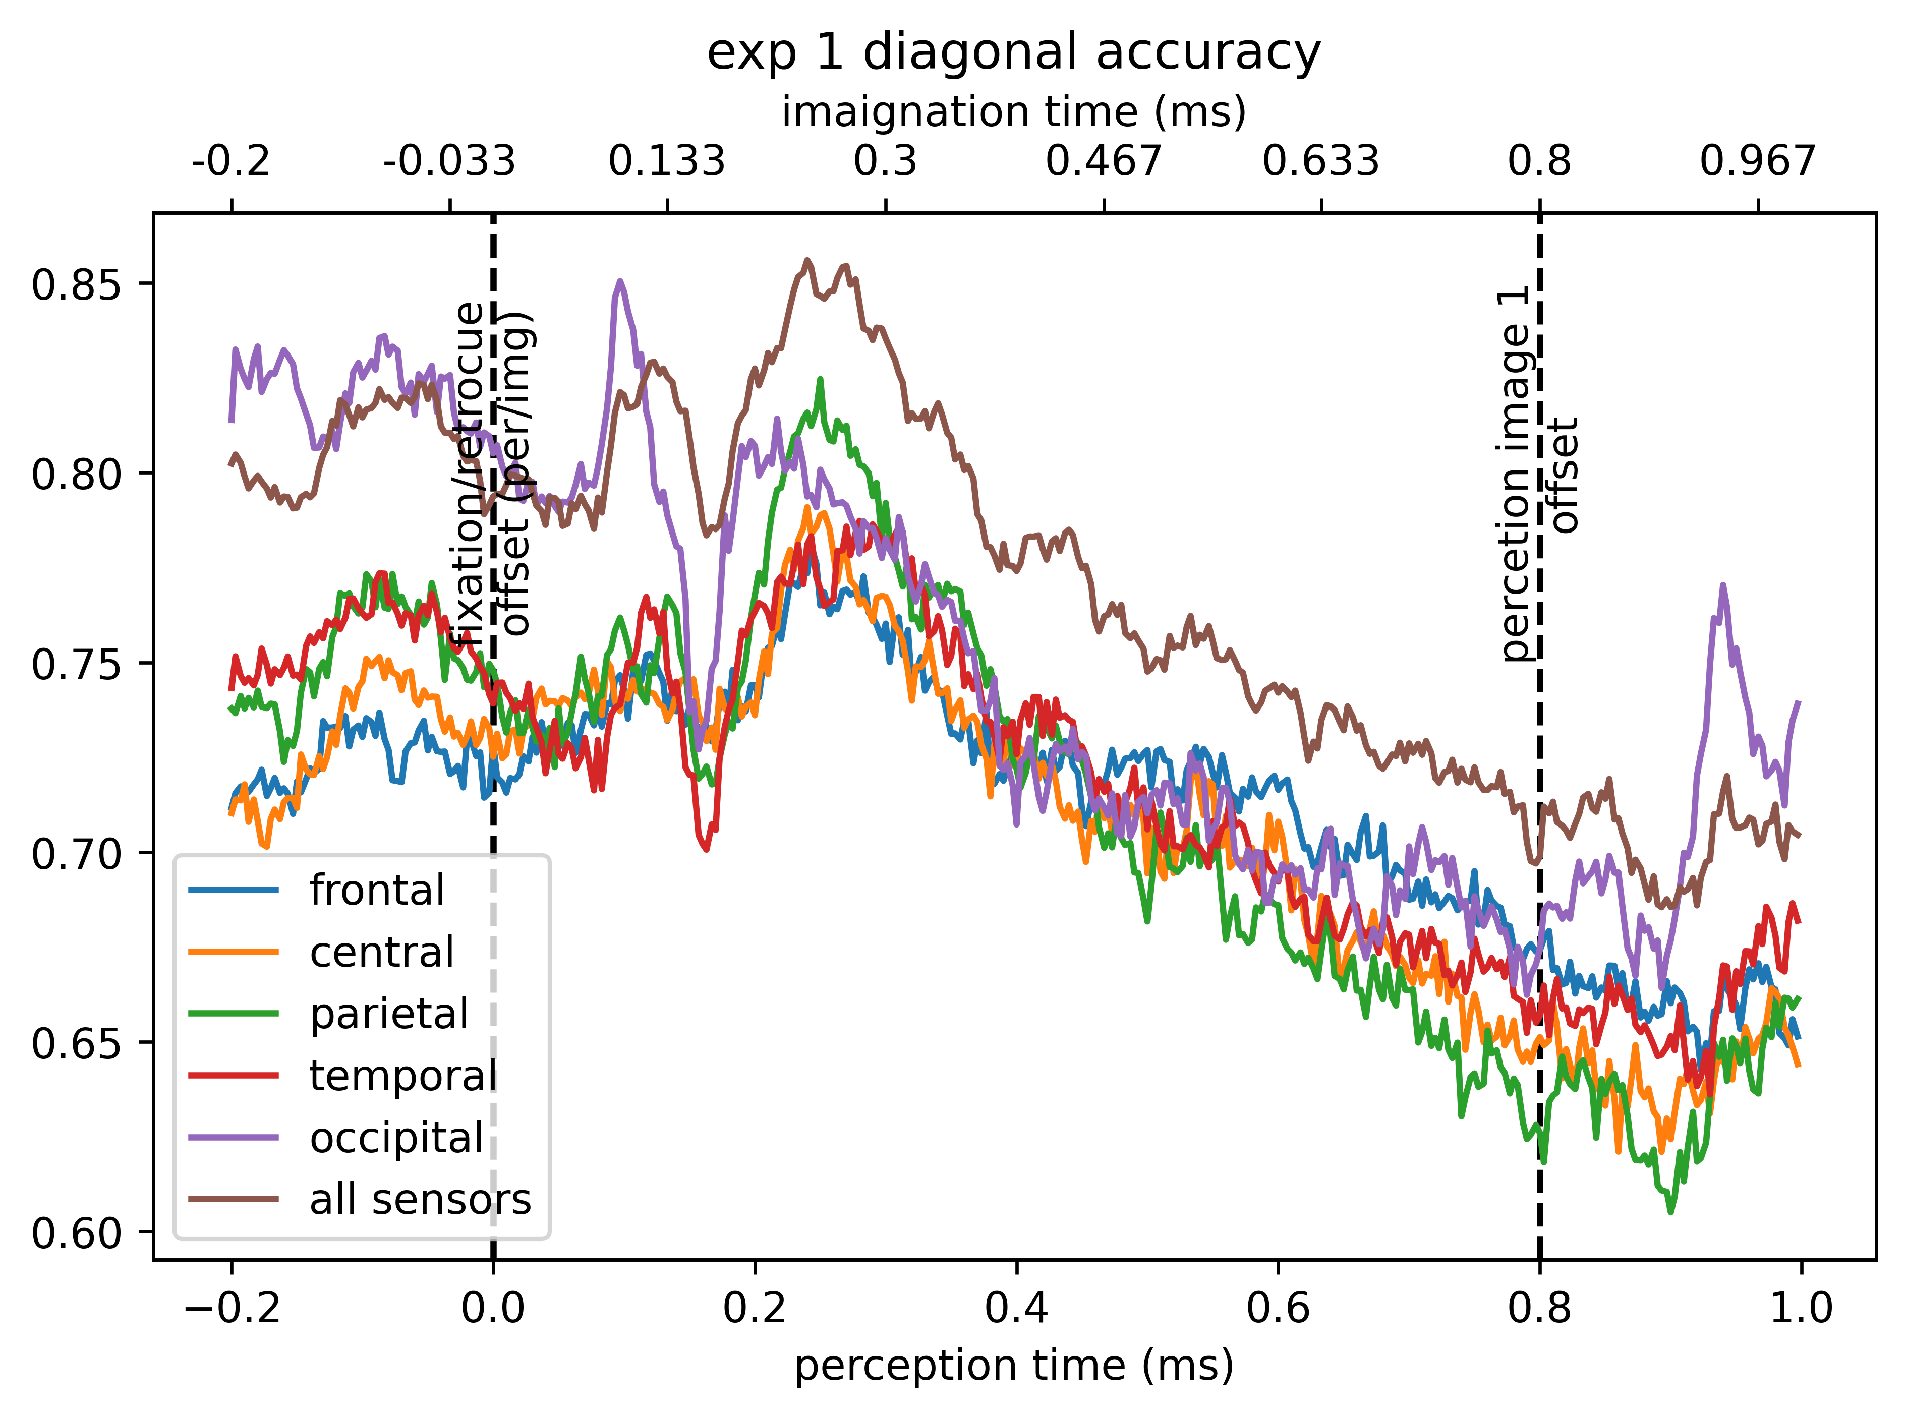
EXPERIMENT 1.C (Diagonal Accuracies of TGM)

Slide 10
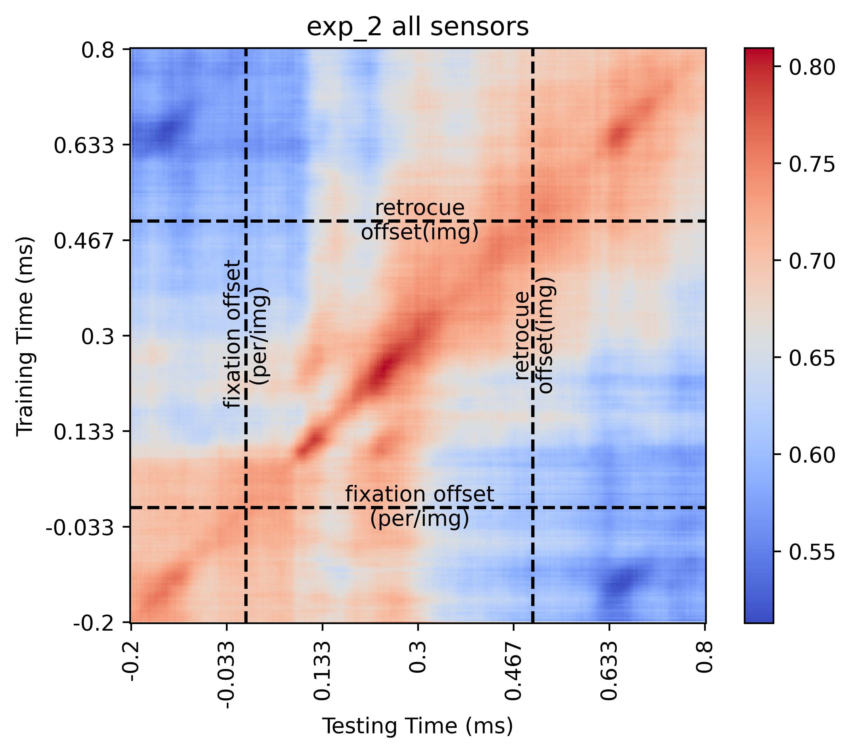
EXPERIMENT 2.A (WHOLE BRAIN LEVEL)
Classifier Used: LDA; Target: Perceived/Imagined condition.
Epoch Time Used:
Perception: 200ms prior to onset of 1st image to 800ms after the onset of 1st image.
Imagination: 200ms prior to pre-cue to 800ms after the onset of pre-cue.

Slide 11
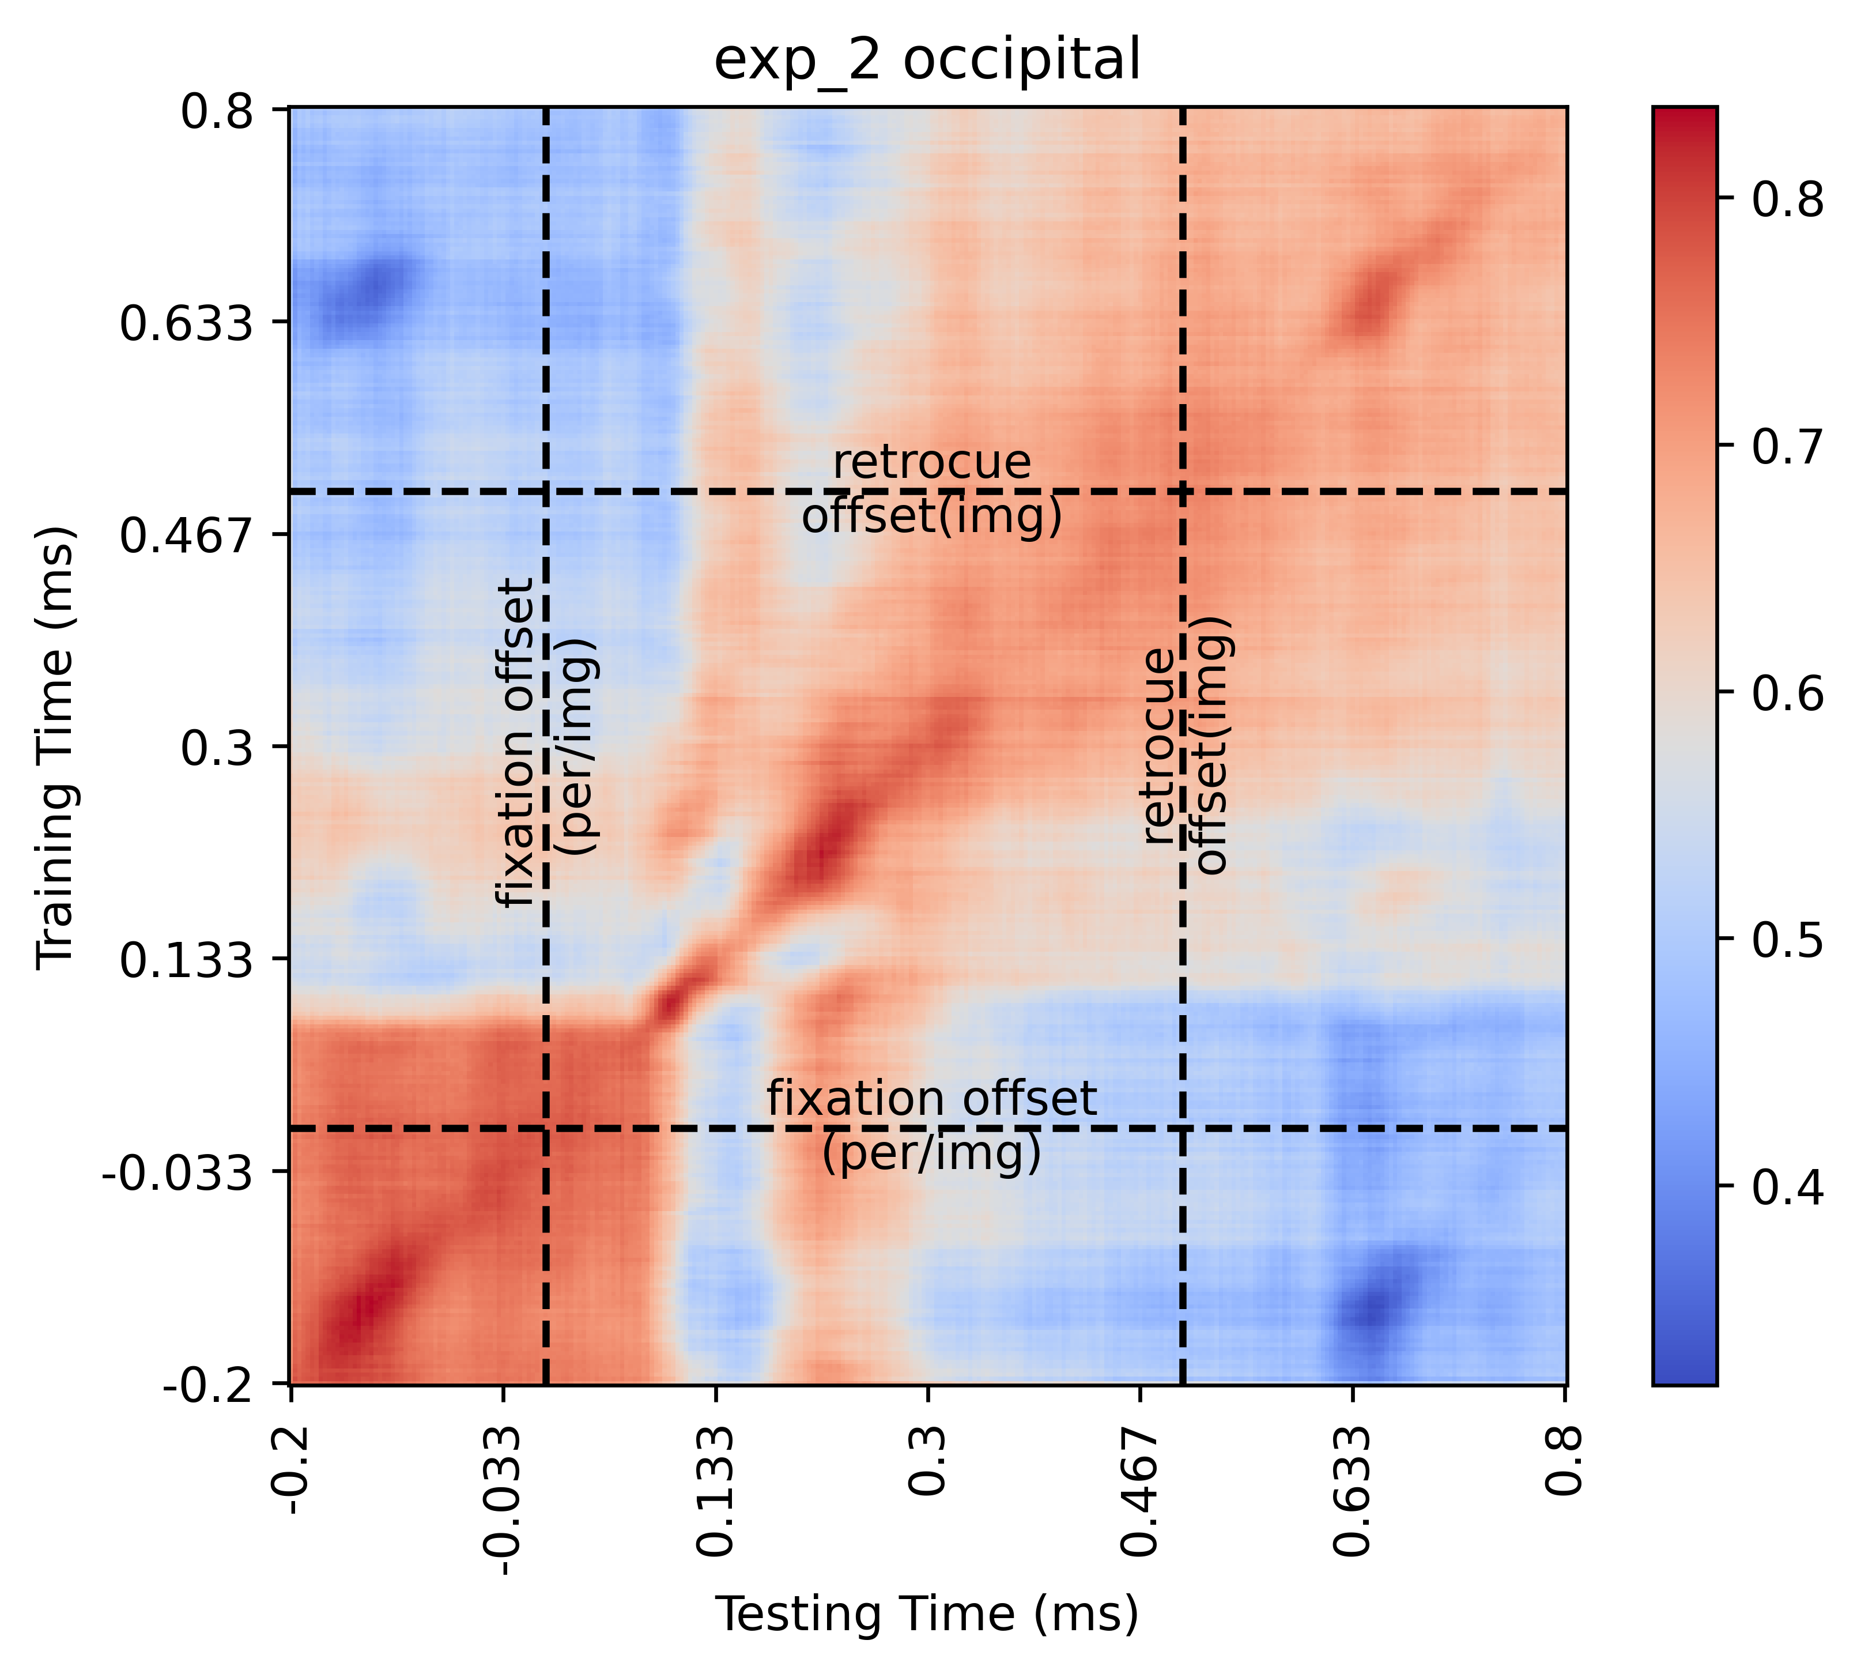
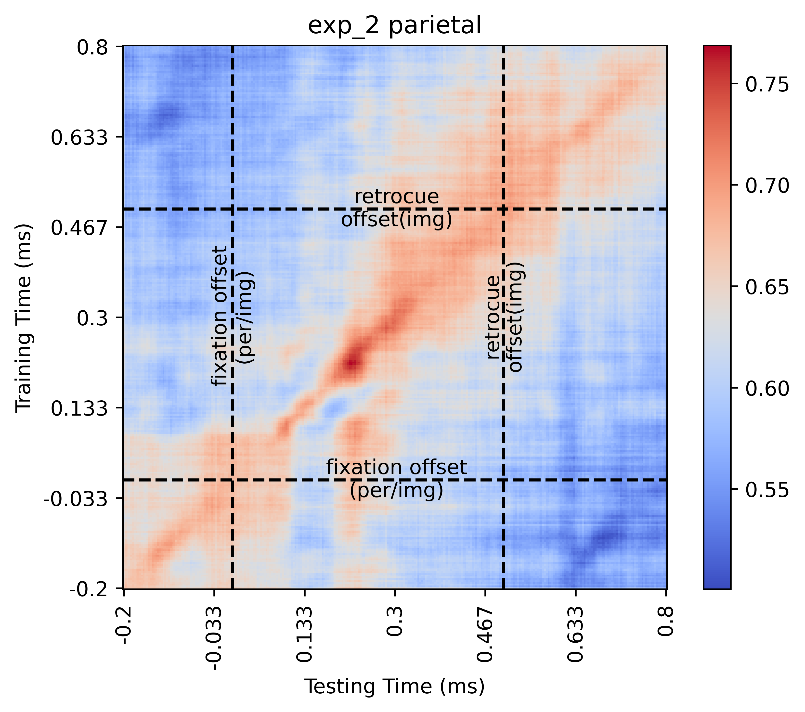
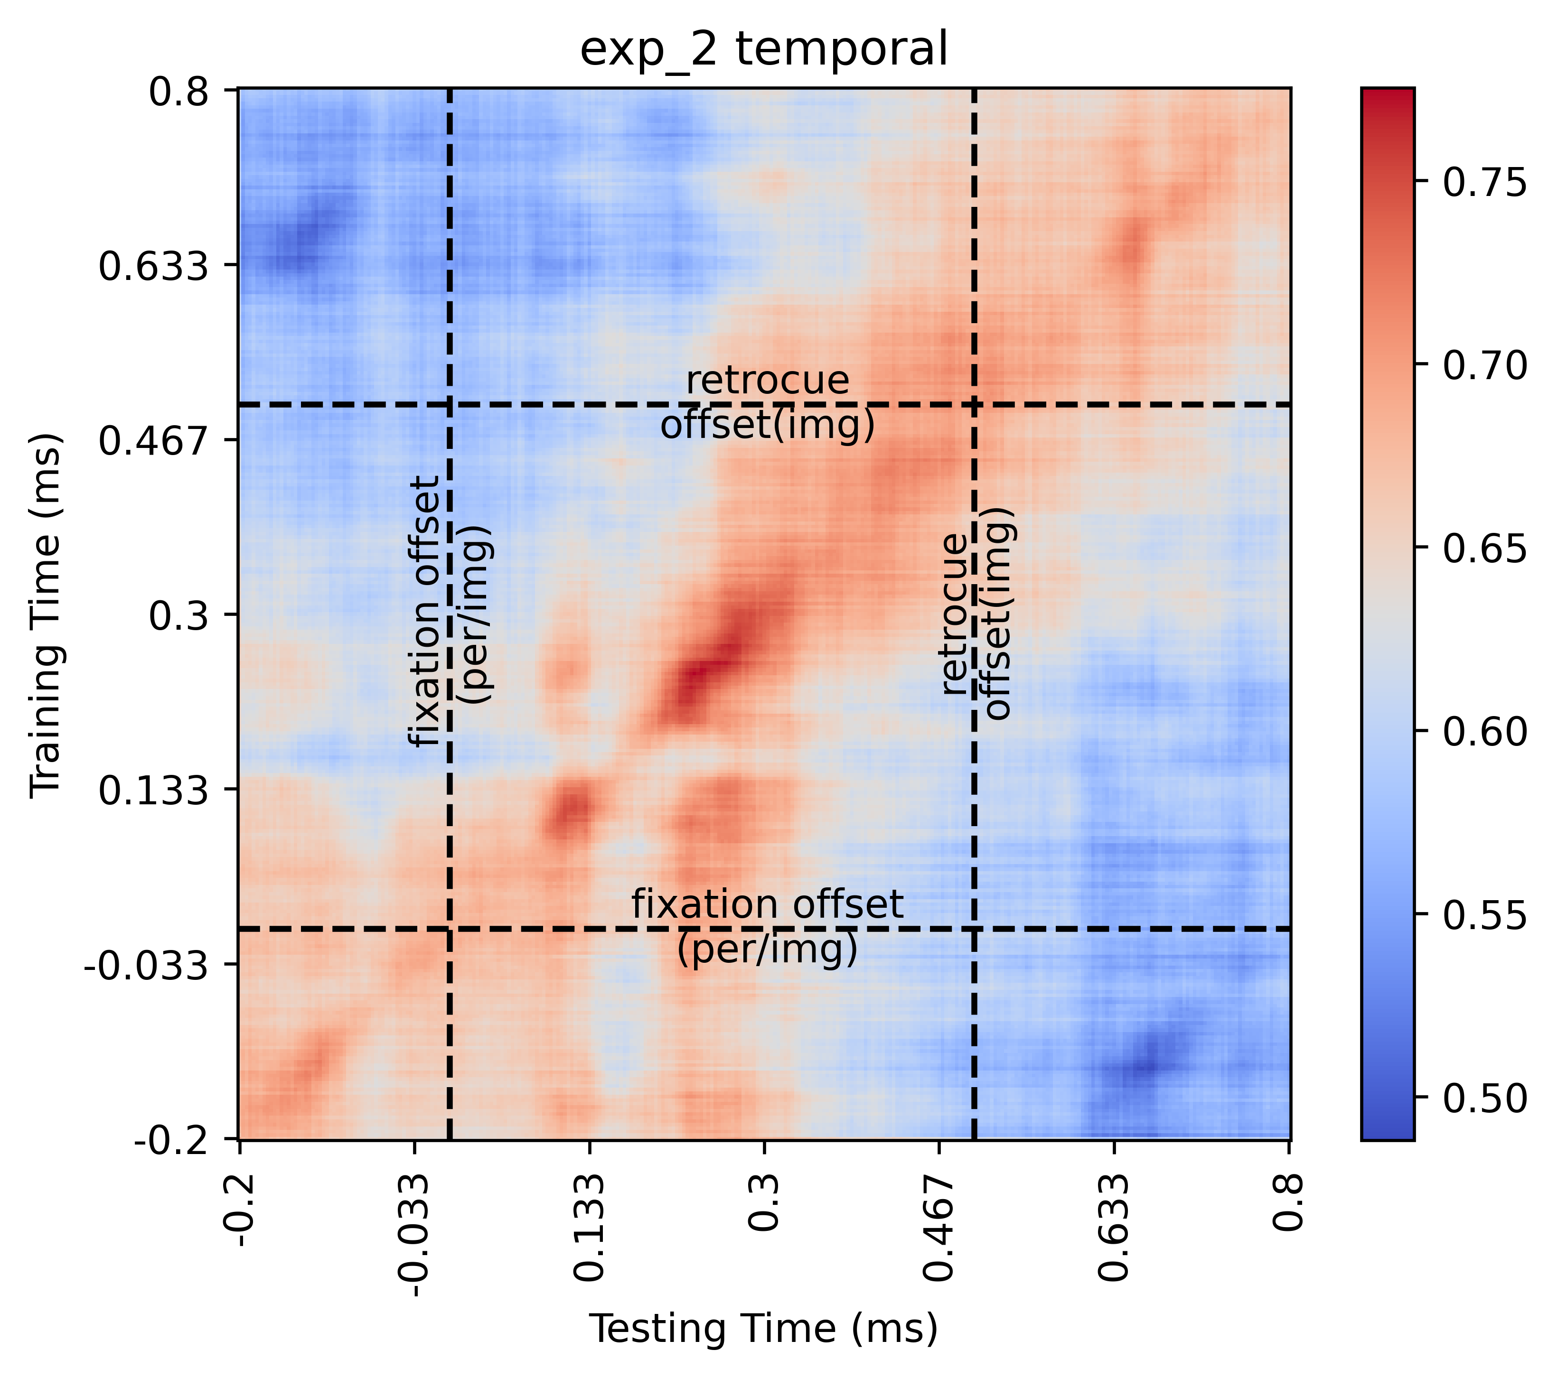
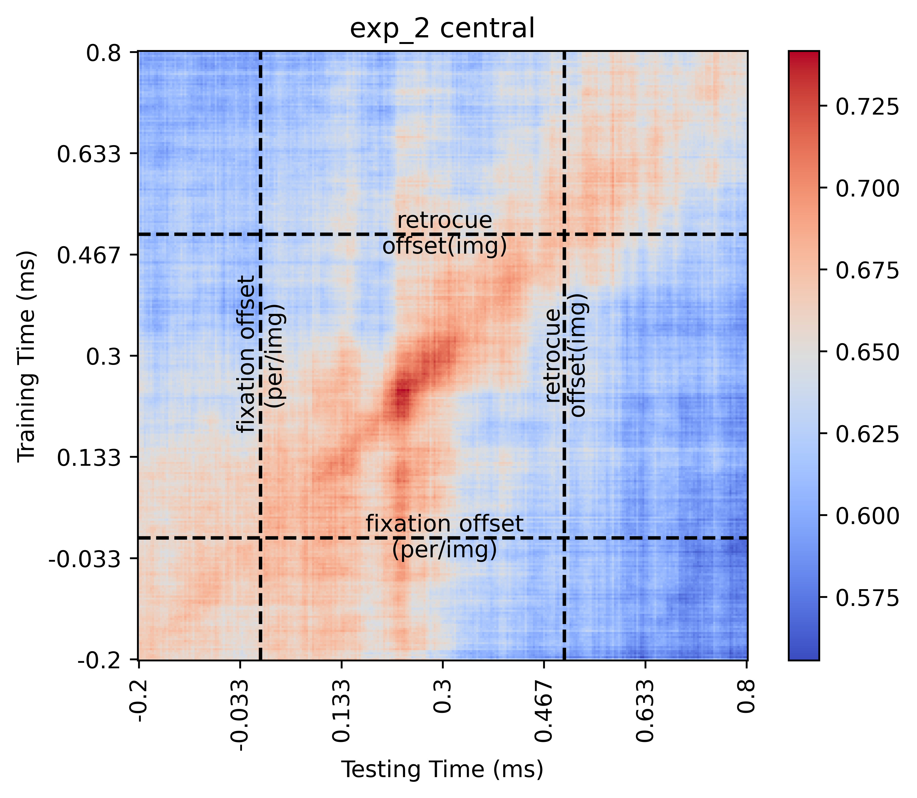
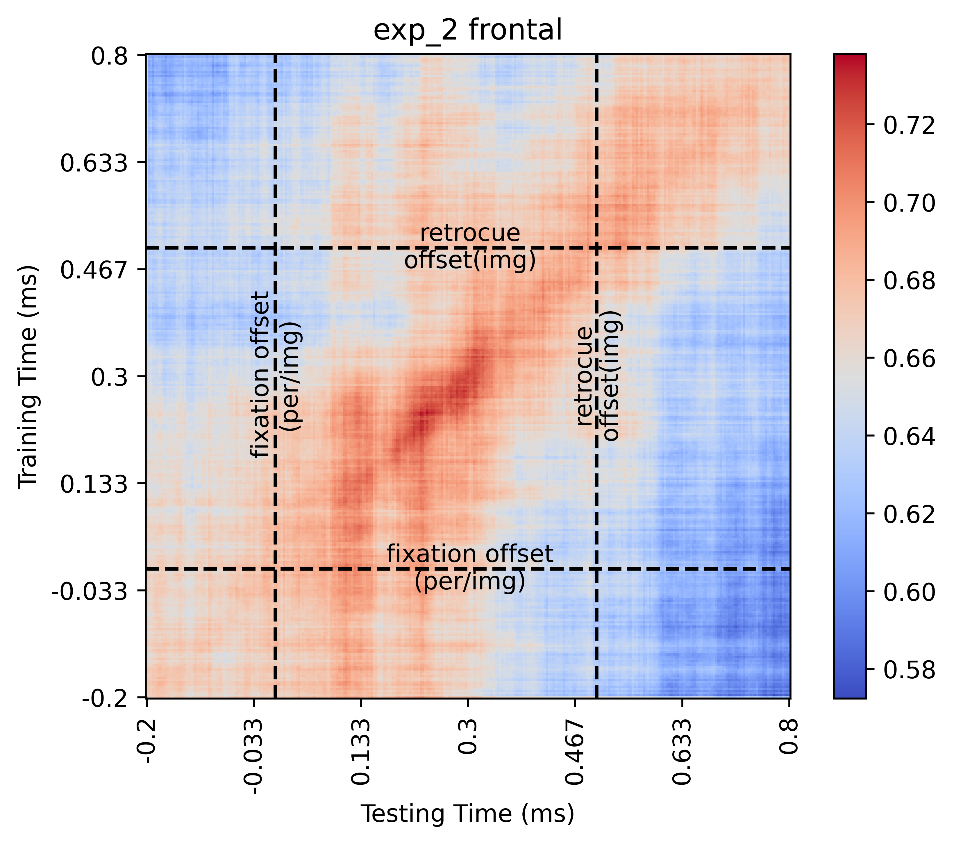
EXPERIMENT 2.B (REGIONAL LEVEL)

Slide 12
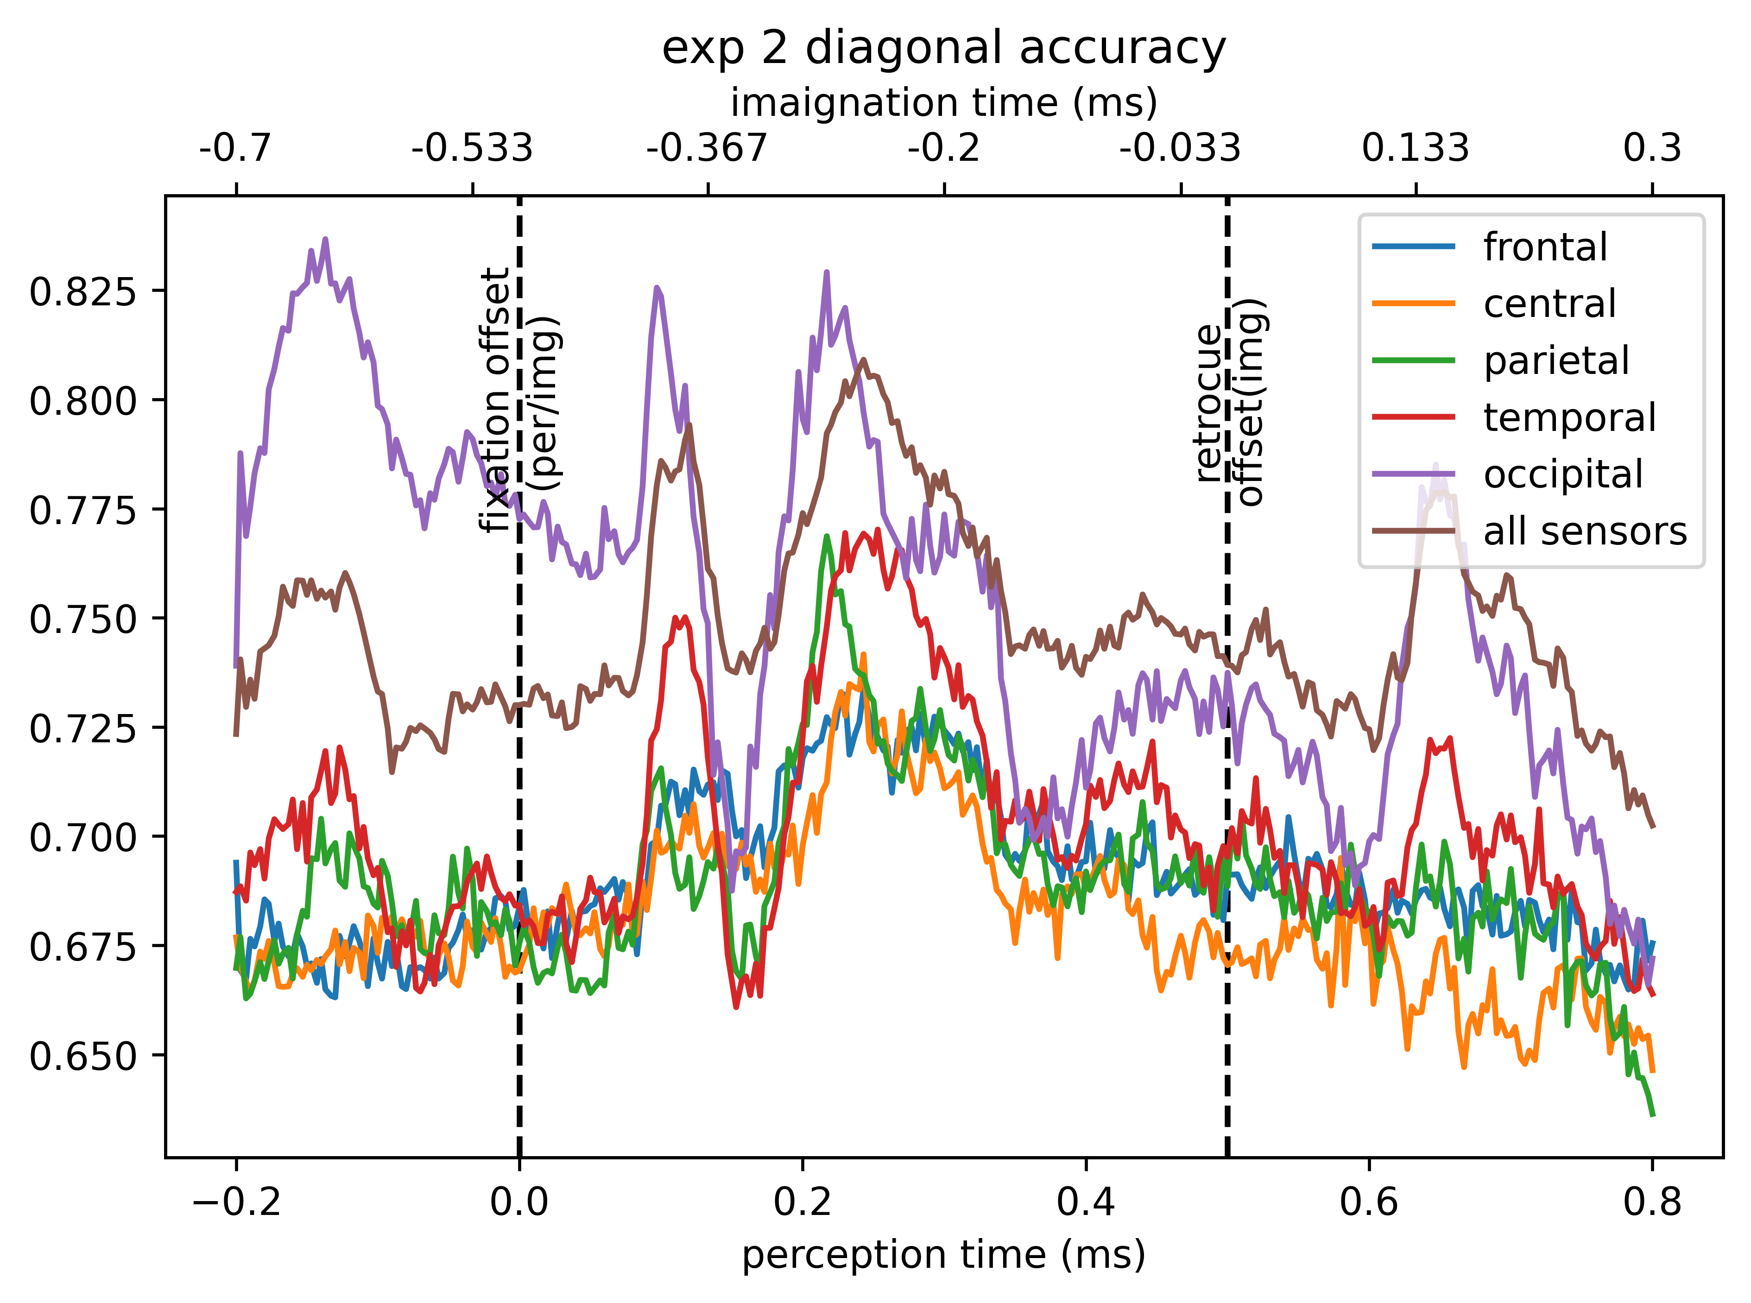
EXPERIMENT 2.C (Diagonal Accuracies of TGM)

Slide 13
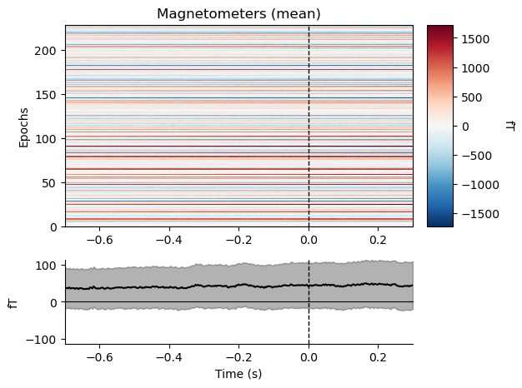
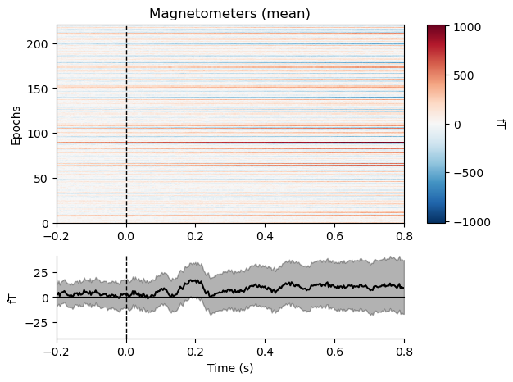
EPOCH PLOT for Experiment 2 in Imagination & Perception trials for 1 random participant.
IMAGINATION
PERCEPTION

